Slide 1
GO Team Meeting
Where we are – Where we’re going

Slide 2
Where We Are
Our strategic plan is the guide for the work we’re doing in the school. By monitoring the plan and ranking priorities, we can all work towards the common goals. Using the priorities in the strategic plan, the school leadership team developed a Continuous Improvement Plan (CIP) for the current school year.

Slide 3
Timeline for GO Teams
You are HERE
1
2
3
4
5
Fall 2021
GO Team Developed 2021-2025 Strategic Plan
Summer 2022
School Leadership completed Needs Assessment and defined overarching needs for SY22-23
August 2022
School Leadership completed 2022-2023 Continuous Improvement Plan
Sept. – Dec. 2022
Utilizing current data, the GO Team will review & possibly update the school strategic priorities and plan
Before Winter Break
GO Team will take action (vote) on the rank of the strategic plan priorities for SY23-24 in preparation for budget discussions.

Slide 4
Discussion Items
Current Strategic Plan
Continuous Improvement Plan
Needs Assessment
SMART GOALS
Monitoring Measures
MAP Data
(Today) Data Protocol

Slide 5
Current Strategic Plan
2021-2025

Slide 6
A caring school embracing community, respect, honesty and hard work.
F. A. Toomer
Strategic Plan
2021-2025
At Toomer, we cultivate global citizens and life-long learners through inquiry, voice, choice, and agency. We provide a safe and equitable community that embraces diversity to inspire students to become critical agents of change.
SMART Goals
Reading
Increase the % of grades 3-5 students scoring proficient or above in reading from 25% to 35% by 2025
Math
Increase the % of grades 3-5 students scoring proficient or above in math from 25% to 35% by 2025
Attendance
By May 2023, our percentage of students meeting CCRPI criteria will increase from 53.6% to 58.3% as indicated on APS graphs and infinite campus.​
APS Strategic Priorities & Initiatives
School Strategic Priorities
School Strategies
Fostering Academic Excellence for All
Data
Curriculum & Instruction
Signature Program
1. Intentionally focus on closing the sub groups achievement gaps.
2. Implement research-based teaching strategies supported by student data.
3. Create a system of supporting problem solving and action with students and staff through the lens of IB.
4. Create and implement a system that promotes equitable practices in all areas of the school community.
-Weekly IB Unit Planning & Reflection
-Mid-Year intervention Plans & data review
-Equity Team/Monthly Meetings
-Intentional 360 instruction around individual learning gaps
-Develop conceptual learning & implementing research based mathematical teaching & learning practices
Building a Culture of Student Support
Whole Child & Intervention
Personalized Learning
5. Foster a system of restorative practices that include students, staff, and families and all wrap around services.
6. Implement a robust wrap around program with clear goals, communication plan, and measurement structure.
-Safety patrol/Restorative student leaders
-Restorative practice committee/Coach next year
-Develop student clubs with clear objectives
-IB Training
-Create pipeline for aspiring leaders through flexible master teacher teams
-Differentiated professional learning & vertical monthly Teaming
-Clearly flesh out new teacher mentor program (Teacher rounds)
Equipping & Empowering Leaders & Staff
Strategic Staff Support
Equitable Resource Allocation
7. Create and support a development path for all staff that includes school based leadership.
8. Foster a “whole adult” system of support.
9. Foster the culture of individualized support for all staff members.
Creating a System of School Support
Collective Action, Engagement & Empowerment
10. Develop and implement a parent engagement plan, based on mutual communication and impact data.
11. Create a mentorship programs for students and staff, students and students, students and parents.
12. Foster a culture of staff, student, parent, and community voice.
-Monthly community engagement
Community coffees
-Student-Led restorative practice group
Quarterly student learning showcase

Slide 7
Continuous Improvement Plan
SY 2022-2023

Slide 8
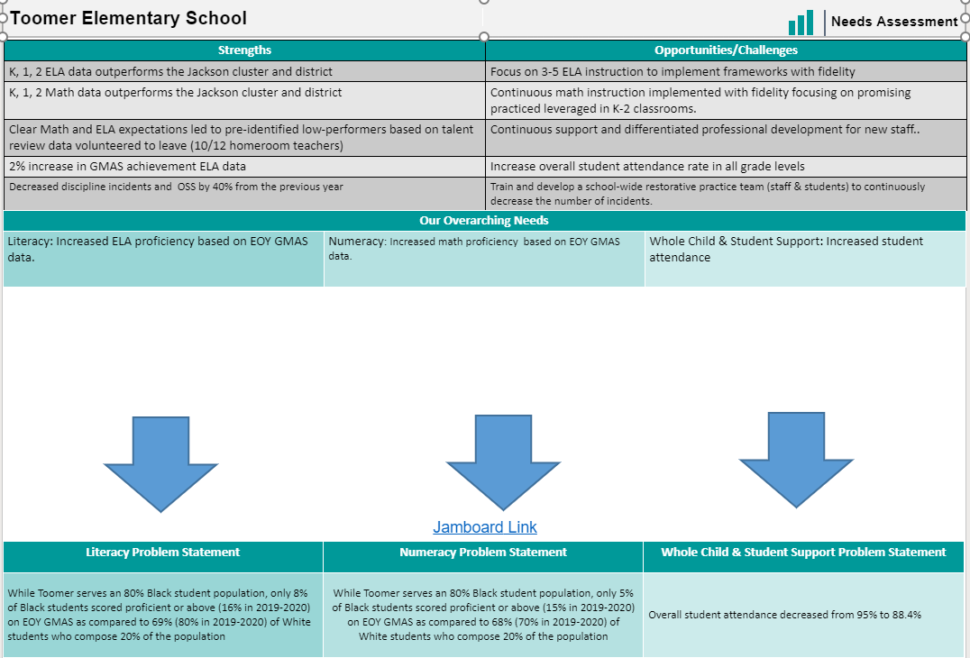
Notes:
Notes for School CIP Teams: After completing your Comprehensive Needs Assessment ( data protocol), you will come here and identify some strengths and opportunities/challenges you have observed from the data. The priority areas are Literacy, Numeracy, and Whole Child & Student Support. Identify an overarching need for each area. Formulate a problem statement for each area. Make sure the problem statement meets the criteria. Refer to your CIP resources.

Slide 9
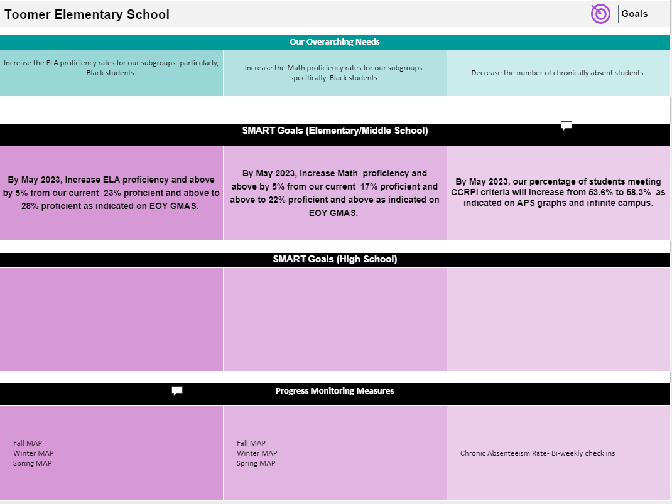

Slide 10
Our Current Progress Monitoring Measures
Literacy
Numeracy
Whole Child
MAP Growth
MAP Growth
Weekly review of the attendance data through the lens of the Attendance committee and CARE Team

Slide 11
MAP Data
2nd Administration

Slide 12
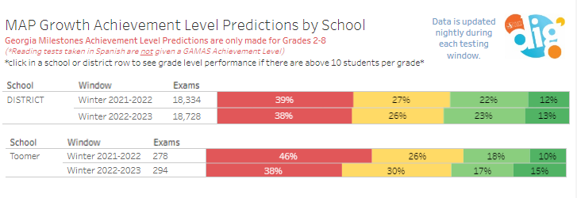
Data: Reading

Slide 13
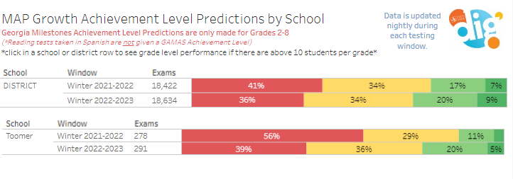
Data: Math

Slide 14
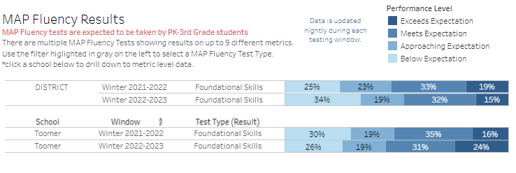
Data: Foundation Skills

Slide 15
Data: Oral Reading Fluency

Slide 16
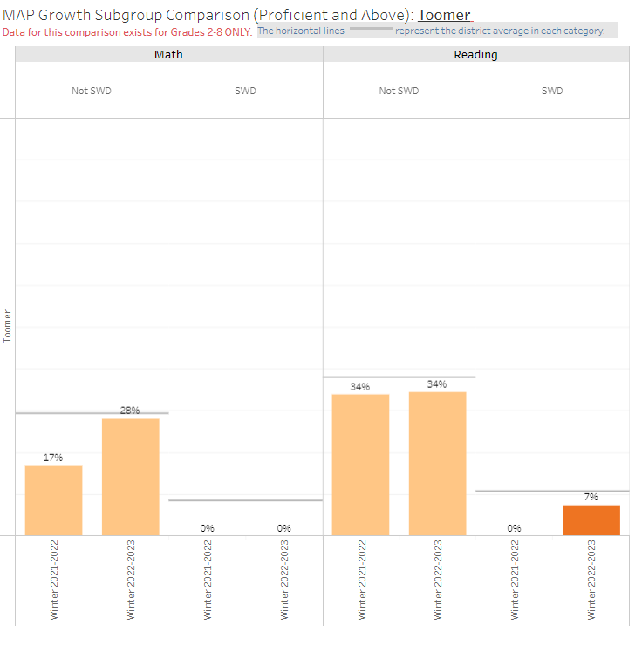
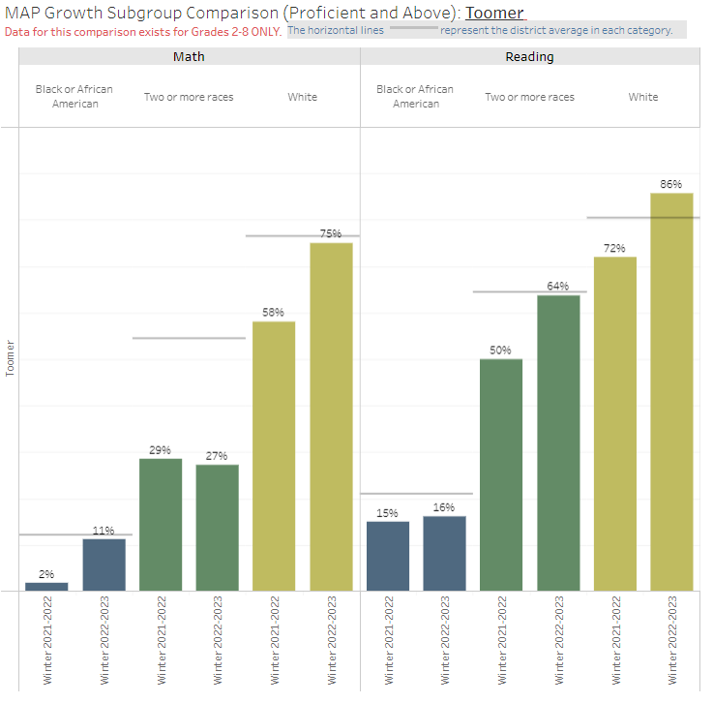
Data

Slide 17
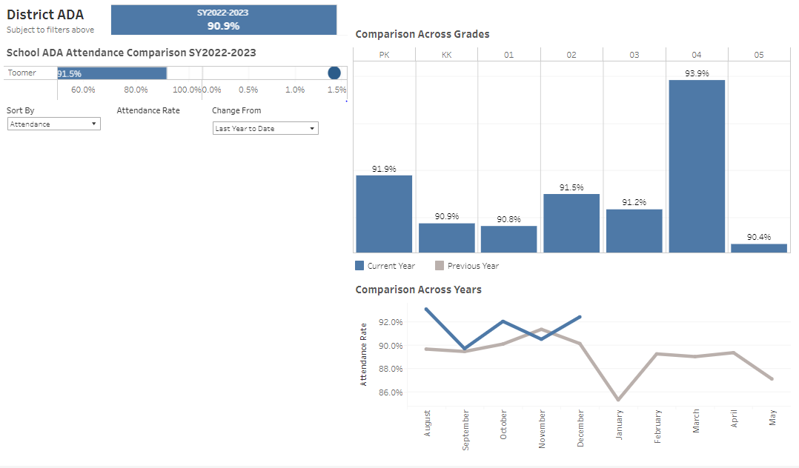
Data

Slide 18
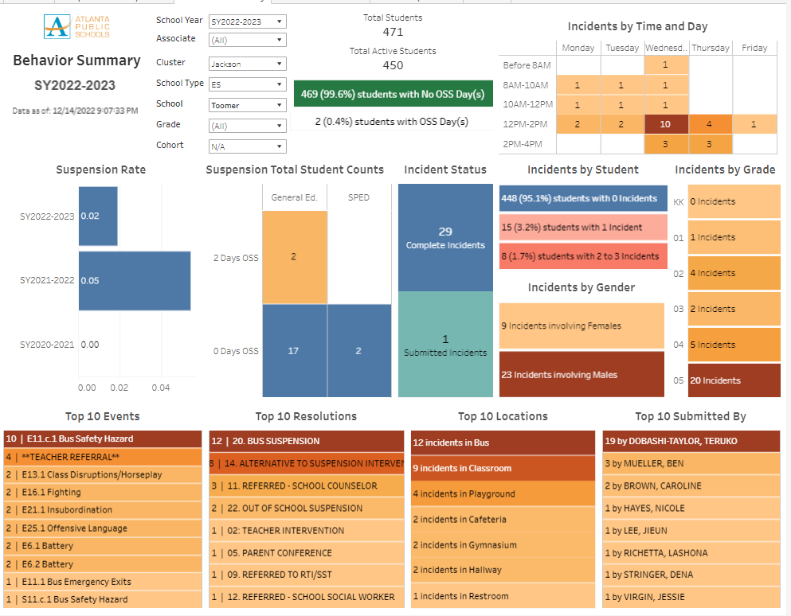

Slide 19
GO Team Discussion: Data Protocol
What do you notice?
What are your wonderings?
What additional questions do you have?

Slide 20
Strategic planning will help you fully uncover your available options, set priorities for them, and define the methods to achieve them.
Robert J. Mckain

Slide 21
Strategic Plan Progress

Slide 22
A caring school embracing community, respect, honesty and hard work.
F. A. Toomer
Strategic Plan
2021-2025
At Toomer, we cultivate global citizens and life-long learners through inquiry, voice, choice, and agency. We provide a safe and equitable community that embraces diversity to inspire students to become critical agents of change.
SMART Goals
Reading
Increase the % of grades 3-5 students scoring proficient or above in reading from 25% to 35% by 2025
Math
Increase the % of grades 3-5 students scoring proficient or above in math from 25% to 35% by 2025
Attendance
By May 2023, our percentage of students meeting CCRPI criteria will increase from 53.6% to 58.3% as indicated on APS graphs and infinite campus.​
APS Strategic Priorities & Initiatives
School Strategic Priorities
School Strategies
Fostering Academic Excellence for All
Data
Curriculum & Instruction
Signature Program
1. Intentionally focus on closing the sub groups achievement gaps.
2. Implement research-based teaching strategies supported by student data.
3. Create a system of supporting problem solving and action with students and staff through the lens of IB.
4. Create and implement a system that promotes equitable practices in all areas of the school community.
-Weekly IB Unit Planning & Reflection
-Mid-Year intervention Plans & data review
-Equity Team/Monthly Meetings
-Intentional 360 instruction around individual learning gaps
-Develop conceptual learning & implementing research based mathematical teaching & learning practices
Building a Culture of Student Support
Whole Child & Intervention
Personalized Learning
5. Foster a system of restorative practices that include students, staff, and families and all wrap around services.
6. Implement a robust wrap around program with clear goals, communication plan, and measurement structure.
-Safety patrol/Restorative student leaders
-Restorative practice committee/Coach next year
-Develop student clubs with clear objectives
-IB Training
-Create pipeline for aspiring leaders through flexible master teacher teams
-Differentiated professional learning & vertical monthly Teaming
-Clearly flesh out new teacher mentor program (Teacher rounds)
Equipping & Empowering Leaders & Staff
Strategic Staff Support
Equitable Resource Allocation
7. Create and support a development path for all staff that includes school based leadership.
8. Foster a “whole adult” system of support.
9. Foster the culture of individualized support for all staff members.
Creating a System of School Support
Collective Action, Engagement & Empowerment
10. Develop and implement a parent engagement plan, based on mutual communication and impact data.
11. Create a mentorship programs for students and staff, students and students, students and parents.
12. Foster a culture of staff, student, parent, and community voice.
-Monthly community engagement
Community coffees
-Student-Led restorative practice group
Quarterly student learning showcase

Slide 23
Activity & Discussion
Review the priorities and goals in your strategic plan and reflect on if the expected progress is being made. These guiding questions will help you determine what, if any, updates are needed for your school’s strategic plan.
Are all CIP Goals reflected in our Strategic Plan Priorities? If not, which CIP Goal(s) are missing and should be added to the Strategic Plan?
What progress has been made towards the priorities identified in our Strategic Plan? What evidence/data do we have?
Based upon available data, are there any other adjustments we need to make to the Strategic Plan?
Notes:
We will do a gallery walk to bring this to the front.

Slide 24
Updates to the
Strategic Plan
Enter all changes/updates to your plan – be sure to include accountability measures, as appropriate.

Slide 25
Questions?
Wonderings?
Comments?

Slide 26
Preparing for Budget Development

Slide 27
You are HERE
1
2
3
4
5
1
2
3
4
5
Fall 2021
GO Team Developed 2021-2025 Strategic Plan
Summer 2022
School Leadership completed Needs Assessment and defined overarching needs for SY22-23
August 2022
School Leadership completed 2022-2023 Continuous Improvement Plan
Sept. – Dec. 2022
Utilizing current data, the GO Team will review & update the school strategic priorities and plan, as needed
Before Winter Break
GO Team will take action (vote) on the school’s strategic plan and vote on the ranked strategic plan priorities for SY23-24 budget discussions.

Slide 28
Action on the Updated Strategic Plan
The GO Team needs to TAKE ACTION (vote) on its updated Strategic Plan. After the motion and a second, the GO Team may have additional discussion. Once discussion is concluded, the GO Team will vote.

Slide 29
Discussion
Strategic Plan Priority Ranking
In preparation for the 2023-2024 Budget Development (January–March 2023), the GO Team needs to rank its Strategic Plan Priorities. Use the next slide to capture the priority ranking.

Slide 30
Strategic Plan
Priority Ranking
Insert the school’s priorities from Higher to Lower
Higher
Lower

Slide 31
Action on the Strategic Plan Priorities
The GO Team needs to TAKE ACTION (vote) on its ranked Strategic Plan Priorities. After the motion and a second, the GO Team may have additional discussion. Once discussion is concluded, the GO Team will vote.

Slide 32
Where we’re going
At our next meeting(s) we will begin the discussion of the 2023-2024 budget.
Let me or the Chair know of any additional information you need for our future discussion.

Slide 33
Thank you

